Slide 1
Emergence of Intelligent Machines: Challenges and Opportunities
CS6700:
The Emergence of Intelligent Machines
Prof. Carla Gomes
Prof. Bart Selman
Cornell University

Slide 2
Artificial Intelligence
After a distinguished history of “overpromising,” AI is finally
making real progress. ☺
1959 --- 1995: “nothing worked” ☹
Positive trajectory started in the late 90s:
1997 IBM’s Deep Blue defeats Kasparov
2005 Stanley --- self-driving car (controlled environment)
IBM’s Watson wins Jeopardy! (question answering)
Speech recognition via “deep learning” (Geoff Hinton)
2014 Computer vision is starting to work (deep learning)
2015 Microsoft demos real-time translation (speech to speech)
Google’s AlphaGo defeats Lee Sedol + AlphaGoZero !!
Watson technology automates 30 mid-level office insurance claim workers, Japan.

Slide 3
The Emergence of Artificial Intelligence
I Emergence of (semi-)intelligent autonomous systems in society
--- Self-driving cars and trucks. Autonomous drones
(surveillance and other). Fully autonomous trading systems.
Household and service robots. Intelligent assistants.
II Shift of AI research from academic to real-world
--- Enabled by qualitative change in the field, driven by “Deep
Learning” / Big Data.

Slide 4
Reasons for Dramatic Progress
--- series of events
--- main one: machine perception is starting to work (finally!)
systems are starting to “hear” and “see” after “only” 50+ yrs or research…
--- dramatic change: lots of AI techniques (reasoning, search,
reinforcement learning, planning, decision theoretic
methods) were developed assuming perceptual inputs were
“somehow” provided to the system. But, e.g., robots could
not really see or hear anything…
(e.g. 2005 Stanley car drove around “blind”, Thrun)
Now, we can use output from a perceptual system and
leverage a broad range of existing AI techniques.
Our systems are finally becoming “grounded in (our) world.”
Already: super-human face recognition (Facebook)
super-human traffic sign recognition (Nvidia)

Slide 5
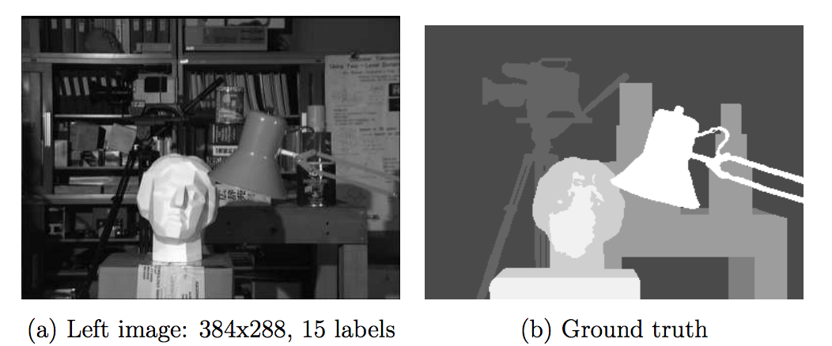
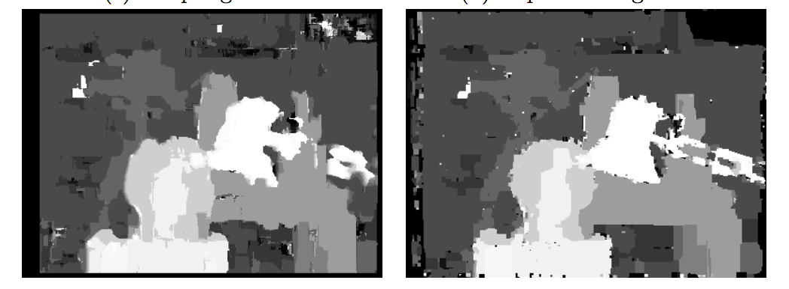
Computer vision / Image Processing ca. 2005
(human labeled)
Processed image

Slide 6
(Nvidia 2016;
Mobileye)
Statistical model (neural net) trained on >1M images;
Models with > 500K parameters
Requires GPU power

Slide 7
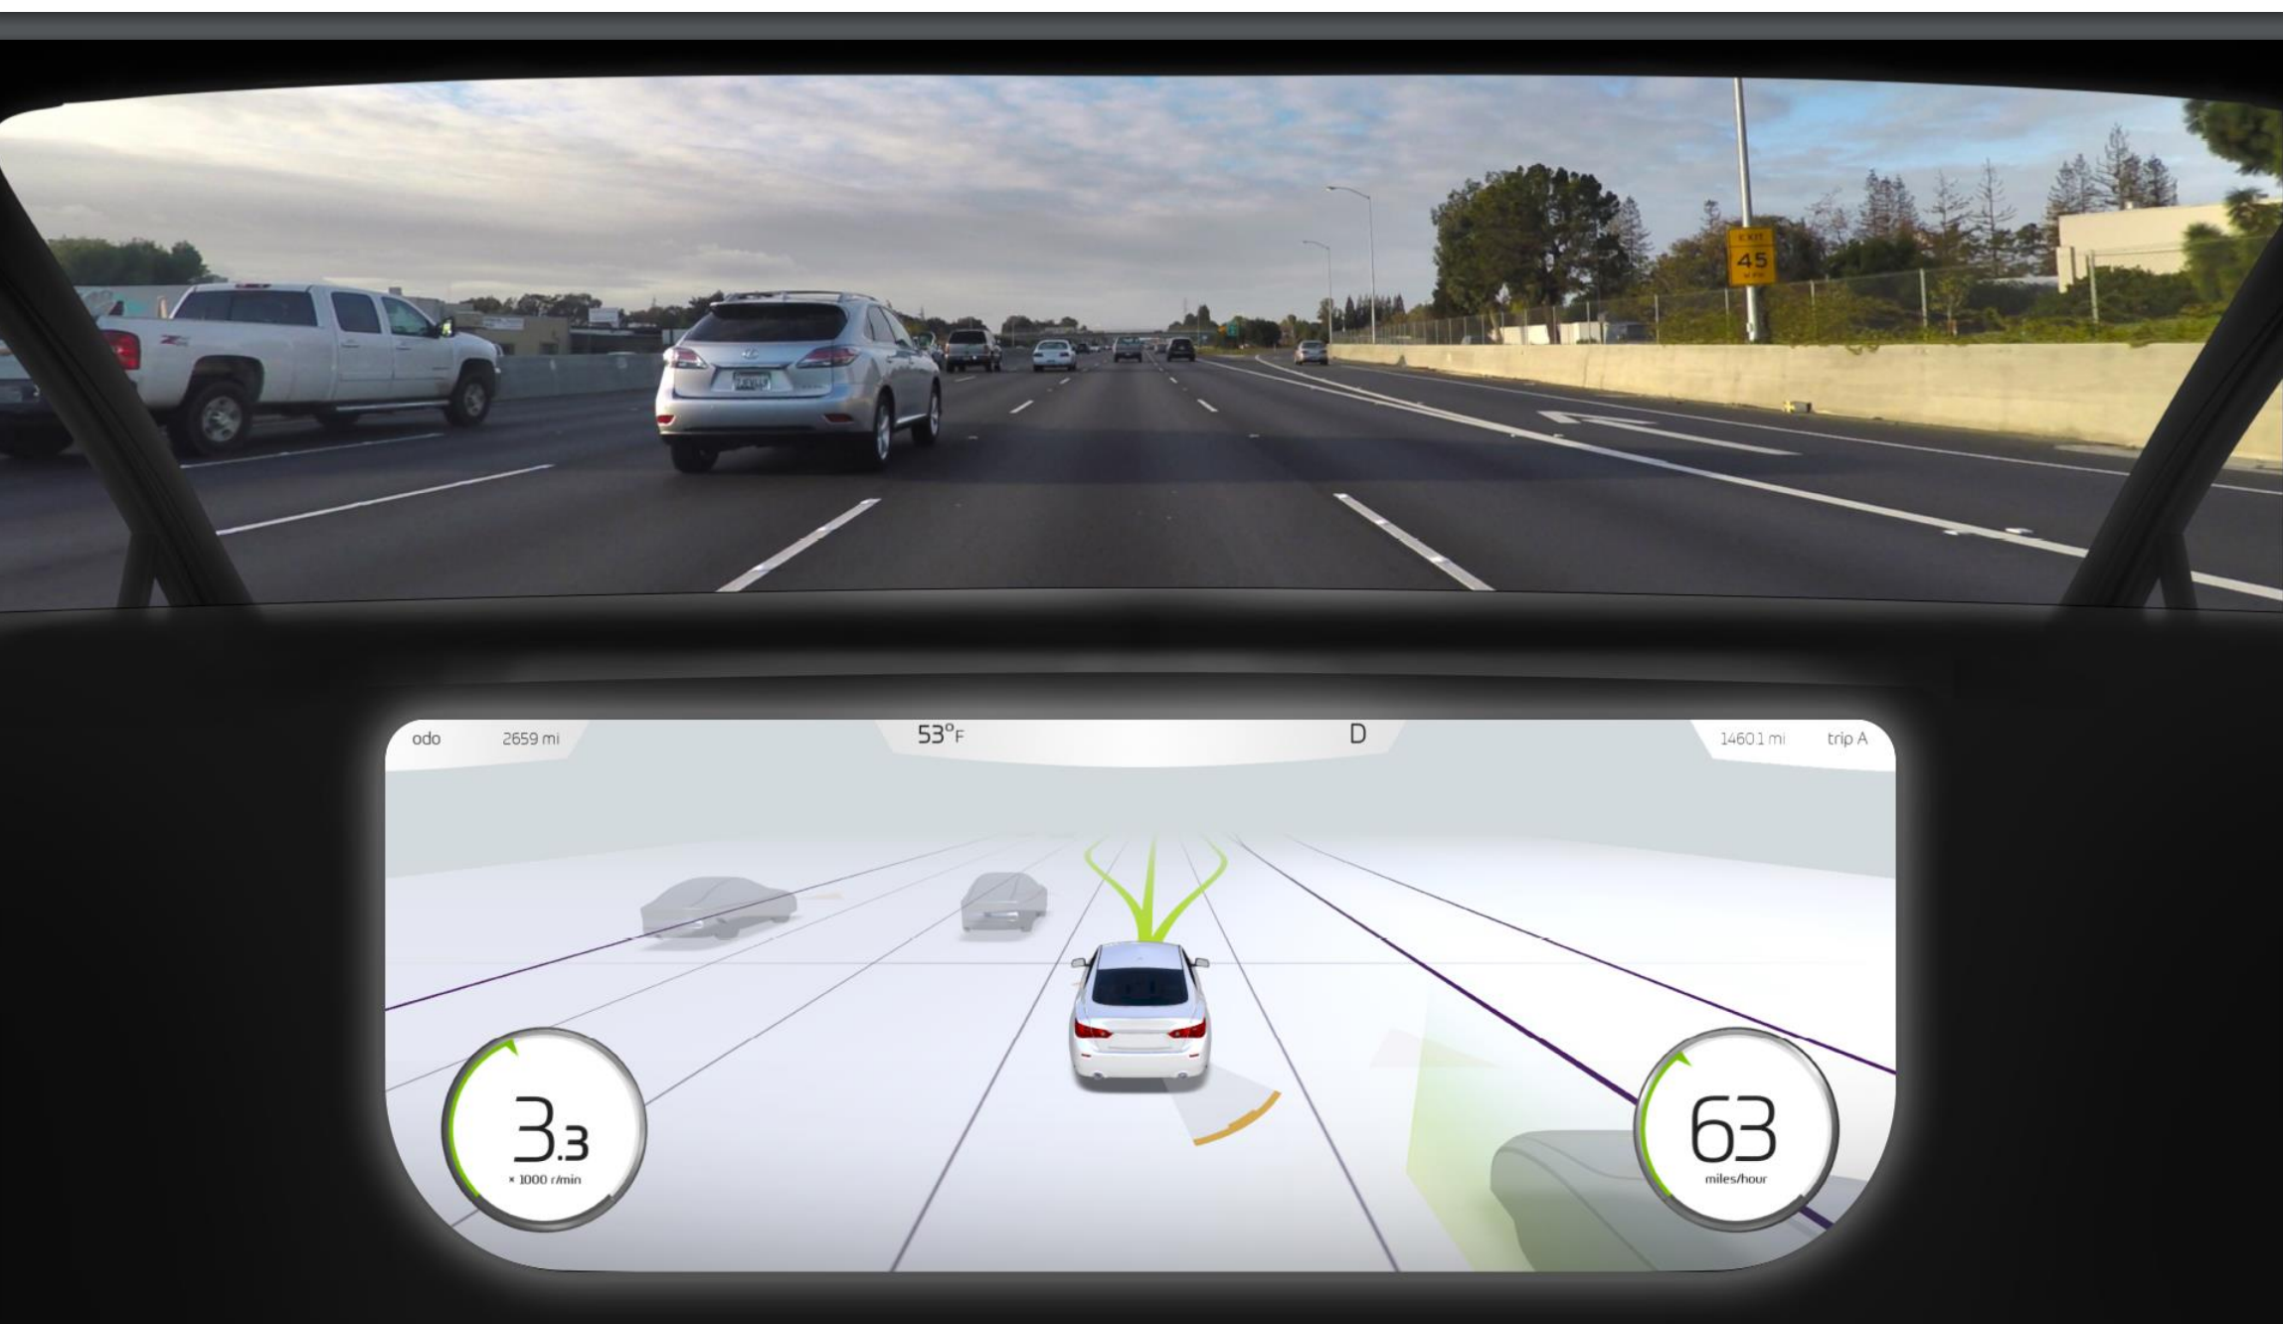
Real-time tracking of environment (360 degrees/ 50+m) and decision making.

Slide 8
Factors in accelerated progress, cont.
--- deep learning / deep neural nets
success is evidence in support of the “hardware hypothesis”
(Moravec) (*)
core neural net ideas from mid 1980s
needed: several orders of magnitude increase
in computational power and data
(aside: this advance was not anticipated/predicted at all;
many AI/ML researchers had moved away from neural nets…)
+ BIG DATA!

Slide 9
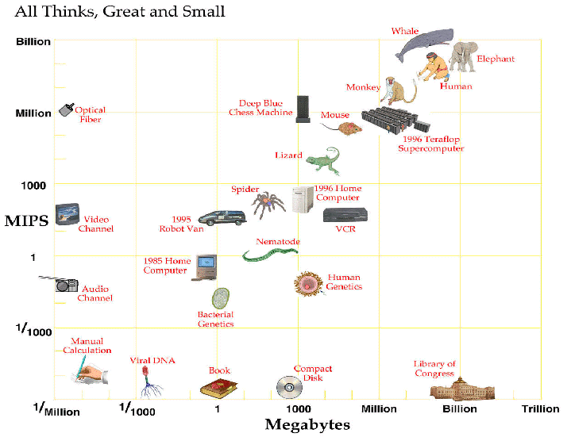
Computer vs. Brain
approx. 2025
Current:
Nvidia: tesla
personal super-
computer
1000 cores
4 teraflop

Slide 10
Progress, cont.
--- crowd-sourced human data --- machines need to understand
our conceptualization of the world. E.g. vision for self driving
cars trained on 100,000+ miles of labeled road data.
--- engineering teams (e.g. IBM’s Watson)
strong commercial interests
at a scale never seen before in our field
--- Investments in AI systems are being scaled-up by an order
of magnitude (to billions).
Google, Facebook, Baidu, IBM, Microsoft, Tesla etc. ($1B+)
+ military ($19B proposed)
An AI arms race

Slide 11
The emergence of intelligent autonomous machines among us is expected to have a major impact on society.
“Preparing for the Future of Artificial Intelligence”
White House Report,
Executive Office of the President, Oct. 2016
Issues:
1) AI Safety & Ethics (Short course this Spring! CS4732)
2) Who benefits?
3) Employment

Slide 12
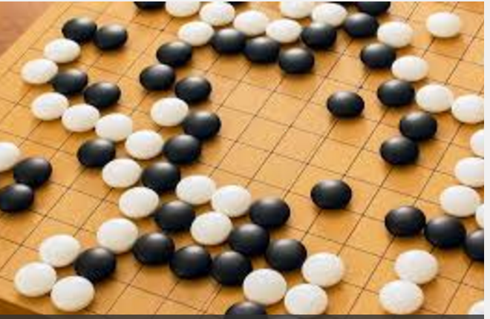
Next Phase
Further integration of existing techniques --- perception, (deep) learning, inference, planning --- will be a game changer for AI systems.
AlphaGo:
Deep Learning
+
Reasoning
(Google/Deepmind 2016)

Slide 13
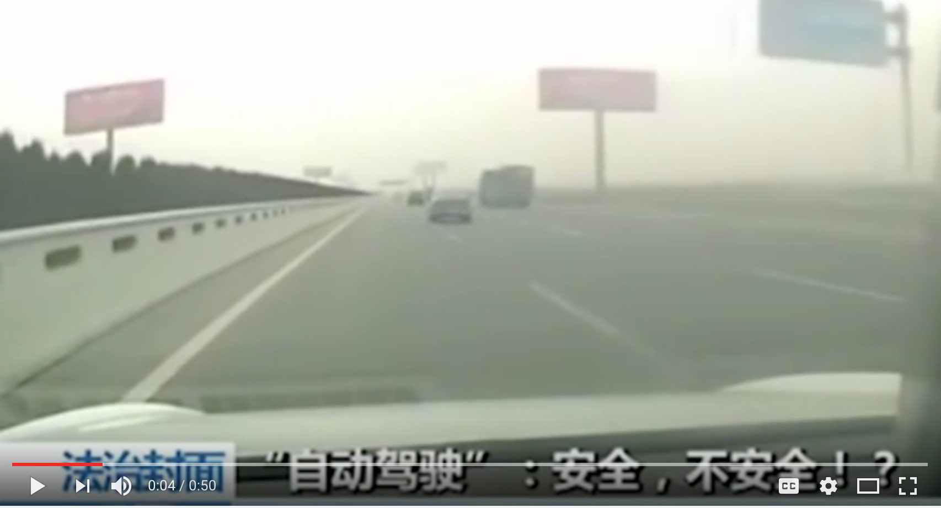
What We Can’t Do Yet
--- Need deeper semantics of natural language
--- Commonsense knowledge and reasoning
Example:
“The large ball crashed right through the table because it was made of Styrofoam.”
What was made of Styrofoam? The large ball or the table?
(Oren Etzioni, Allen AI Institute)
Commonsense is
needed to deal with
unforeseen cases.
(i.e., cases not in training
data)
China Tesla crash --- consider how human driver handles this!
You Tube: Tesla crashes into an orange streetsweeper on Autopilot –Chinese Media

Slide 14
See Non-Human Intelligence slides

Slide 15
Comp. Compl. / Intelligence Hierarchy
EXP-complete:
games like Go, …
EXP
Hard
PSPACE-complete:
QBF, planning, chess (bounded), …
PSPACE
MACHINES
#P-complete/hard:
#SAT, sampling, probabilistic inference, …
P^#P
PH
NP-complete:
SAT, propositional
reasoning, scheduling, graph coloring, puzzles, …
NP
P-complete:
circuit-value, …
HUMANS
P
In P:
sorting, shortest path, …
What are the consequences for human understanding
of machine intelligence?
Easy

